Slide 1
Are You at Risk for a Stroke?
The Answers May Surprise you...

Slide 2
Stroke Data Analysis
By: Matthew Harmon, Jessie Ju, Abby Schneider, Sean Stevens-Fabry

Slide 3
Stroke Risk
Stroke is a leading cause of death in the United States, with over 795,000 people in the U.S. having one per year. Every 40 seconds someone in the U.S. has a stroke, and every 4 minutes someone dies from one. This project assesses risk factors associated with having a stroke.

Slide 4
Questions
Questions we hope to answer with data:
What are the leading risk factors for having a stroke?
Can we use this data to accurately predict risk of someone having a stroke?
What other questions does this investigation raise?

Slide 5
Data Source
Stroke Prediction Dataset - a private dataset off of Kaggle
Framingham - The Framingham Heart Study is a long-term, ongoing cardiovascular cohort study of residents of the city of Framingham, Massachusetts
Notes:
Stroke Prediction Dataset - this is a private dataset off of Kaggle, this dataset is used to predict whether a patient is likely to have a stroke based on the input parameters like gender, age, various diseases, and smoking status. It lists data for about 5000 patients.
Framingham - The Framingham Heart Study is a long-term, ongoing cardiovascular cohort study of residents of the city of Framingham, Massachusetts. The study began in 1948 with 5,209 adult subjects from Framingham, and is now on its third generation of participants.

Slide 6
Description
We used various descriptive statistics to examine the datasets.
We then used Supervised Machine Learning to create a predictive model to determine risk.

Slide 7
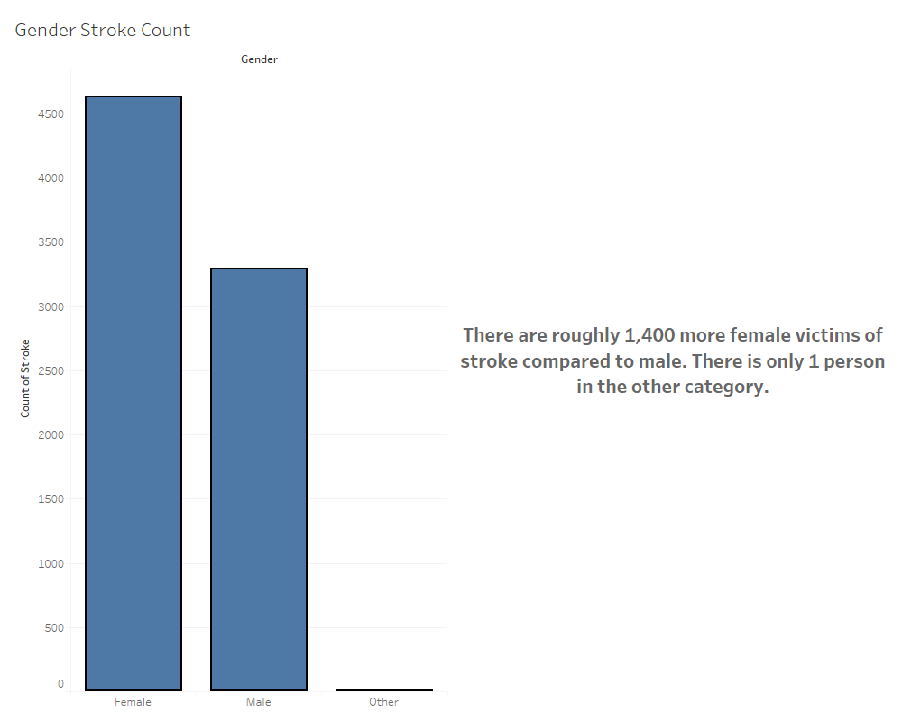
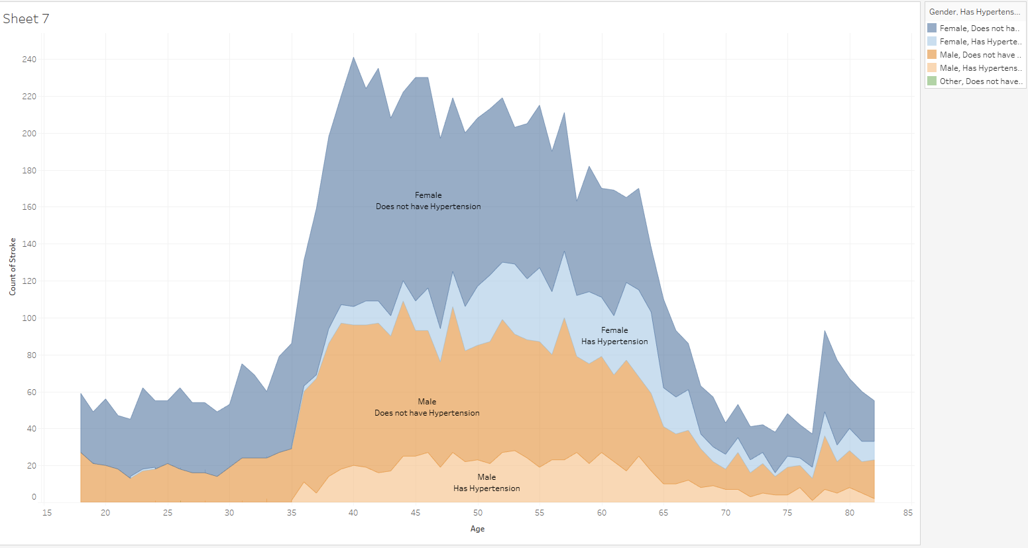
Notes:
Sean starts

Slide 8
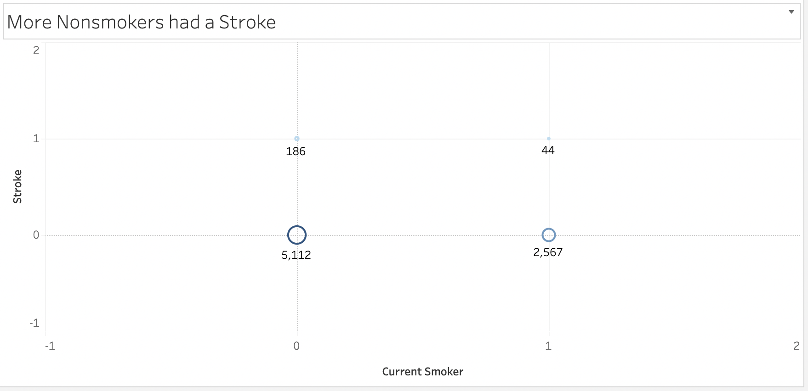
Stroke Risk vs. Smoking

Slide 9
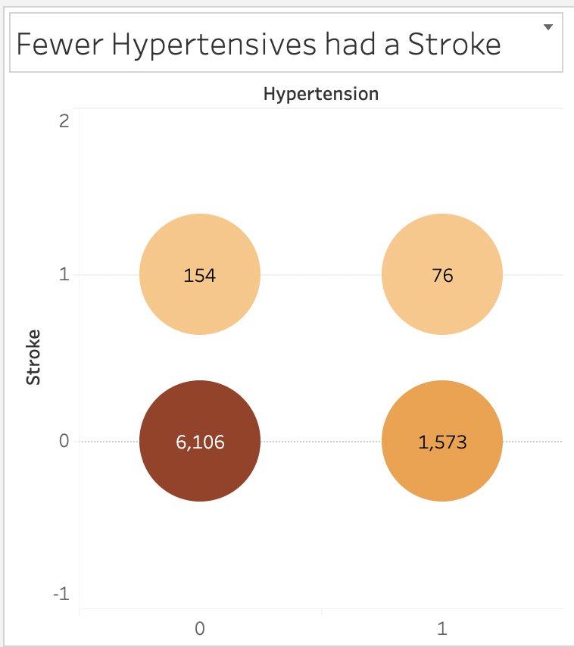
Hypertension Effect
As seen in the chart, people with hypertension had less chance of stroke.

Slide 10
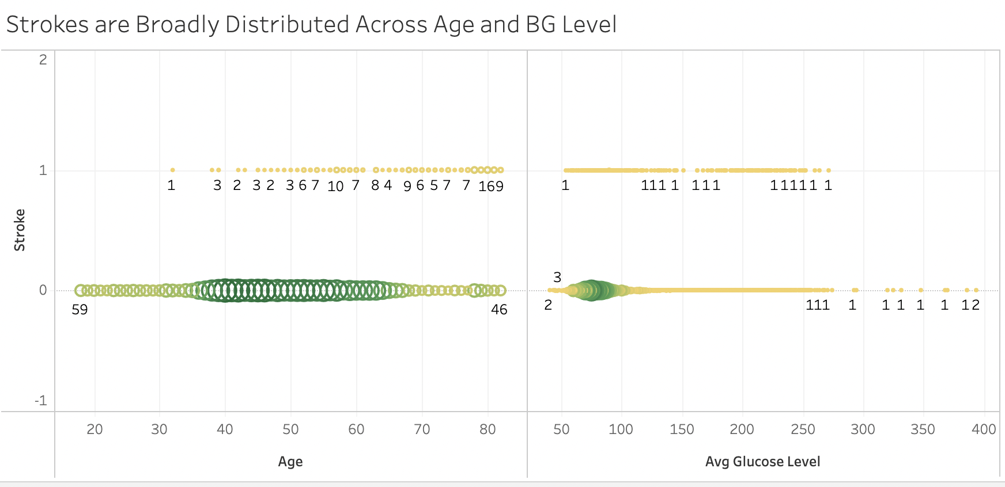
Stroke Risk Compared with Age and Glucose Level

Slide 11
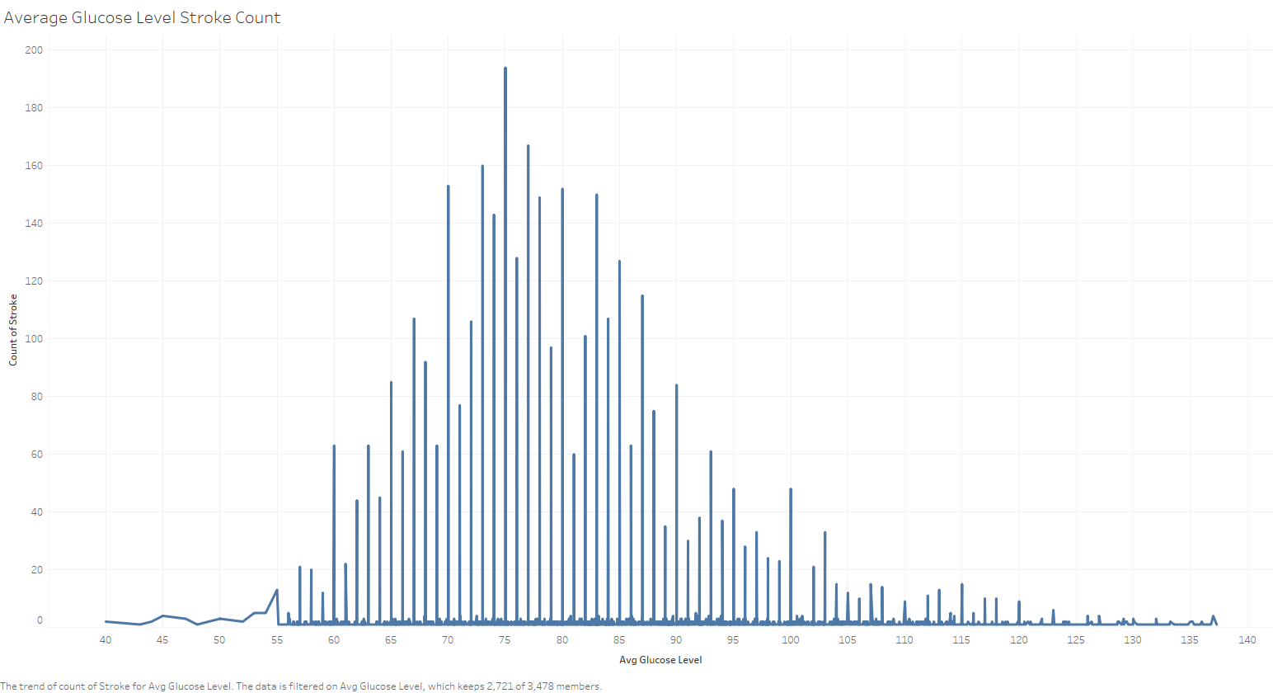

Slide 12
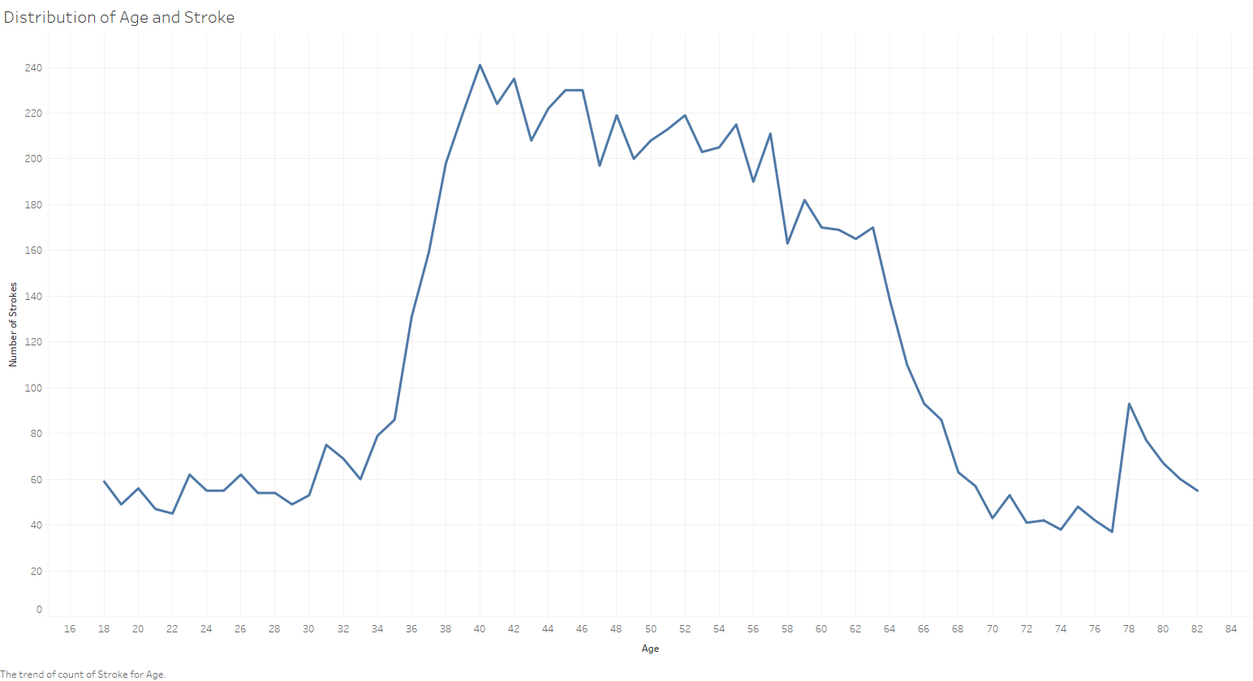

Slide 13
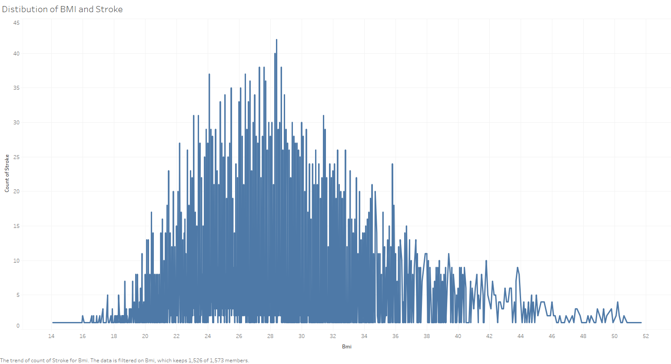

Slide 14
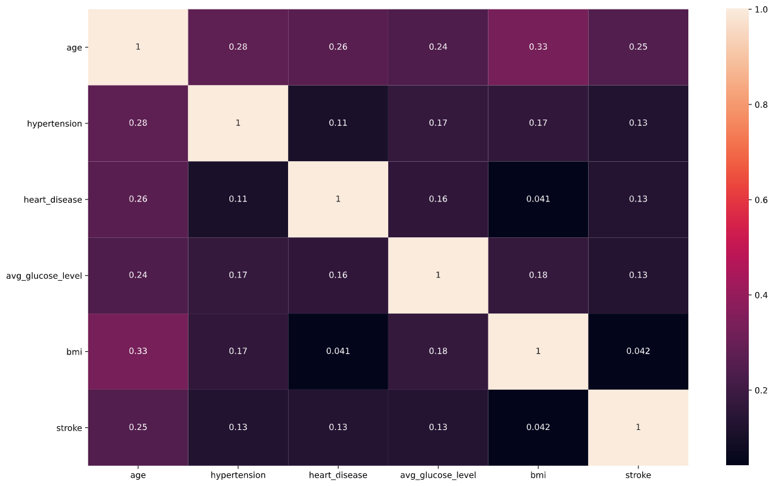
Analysis
A Correlation Matrix of Features

Slide 15
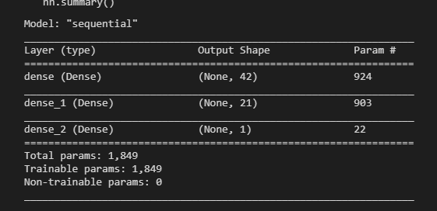
The Machine Learning Model
We chose to use Tensorflow Neural Network framework to build the model of our data.
We chose the Tensorflow Neural Network because it yielded a high accuracy rating.
It was built using the sequential model with 2 hidden layers using the “relu” function and 1 output layer using “sigmoid”.
Notes:
Harmon - We chose to use Tensorflow Neural Network framework to build the model of our data. We did not try other ML frameworks due to Tensorflow yielded a high accuracy and felt that we didn’t really need to do others.

Slide 16
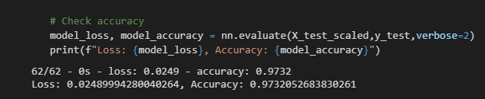
The Machine Learning Model
As we can see, the model that was built has an accuracy of 97.32%, which is fairly accurate. Of course, if you were predicted to be at risk of stroke using this model, see a professional for diagnosis.
Notes:
Harmon - As you can see, even after 1 epoch, we yielded a 97.32% accuracy. We created a web application that uses this model to predict your chance for stroke.

Slide 17
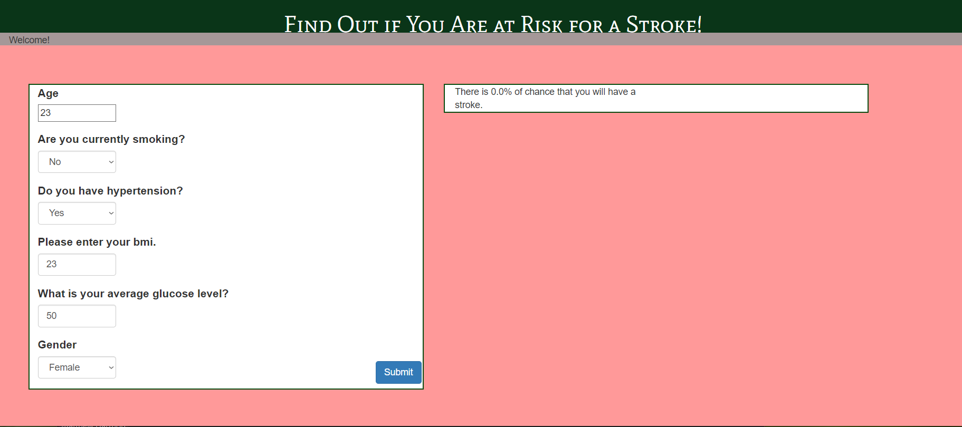
Interactive Interface
https://stroke-risk-analysis.herokuapp.com/
Notes:
The purpose of this project is to predict one’s chance of getting a stroke, thus I have made an interactive interface using HTML. I will now do a demonstration of the website (opens website).
As one can see, users will be able to enter their age, smoking status, hypertension status, BMI, glucose level, as well as their gender (enter my stats). The prediction is obviously not overwhelmingly accurate, since we only had so much data to work with, which brings me to the next topic of limitations as well as future questions (click slide).

Slide 18
Questions for Future Analysis
Age, gender, HTN status, Avg. Glu, smoking status were the risk factors we had to work with but may not explain the whole picture. So what can we do to better understand stroke?
Consider other factors that contribute to stroke risk
Find more data and incorporate a larger dataset
Where did the Kaggle data come from?
Utilize machine learning model that yields more actionable output
Notes:
These are questions that we could potentially look into in order to help users make better decisions based on their likelihood of getting a stroke (read slide).

Slide 19
Technologies Used
Technologies, languages, tools, and algorithms used throughout the project:
Jupyter Notebook: Pandas will be used to clean the data and perform an exploratory analysis. Further analysis will be completed using Python.
PostgreSQL: Joins the two datasets into one.
Tableau: Visualization for the datasets.
Google Slides: Used for presentation.
Heroku: Executes the application by running a Procfile command.
GitHub: Organises files.
Slack: For communication amongst team members.
Notes:
In order to analyse the dataset to the best of our ability, we have used a plethora of technologies, languages, tools, and algos (read rest of slide).

Slide 20
Take stroke warning signs seriously!
F
Face Drooping
A
Arm
Weakness
S
Speech
Difficulty
T
Time to Call 911!

Slide 21
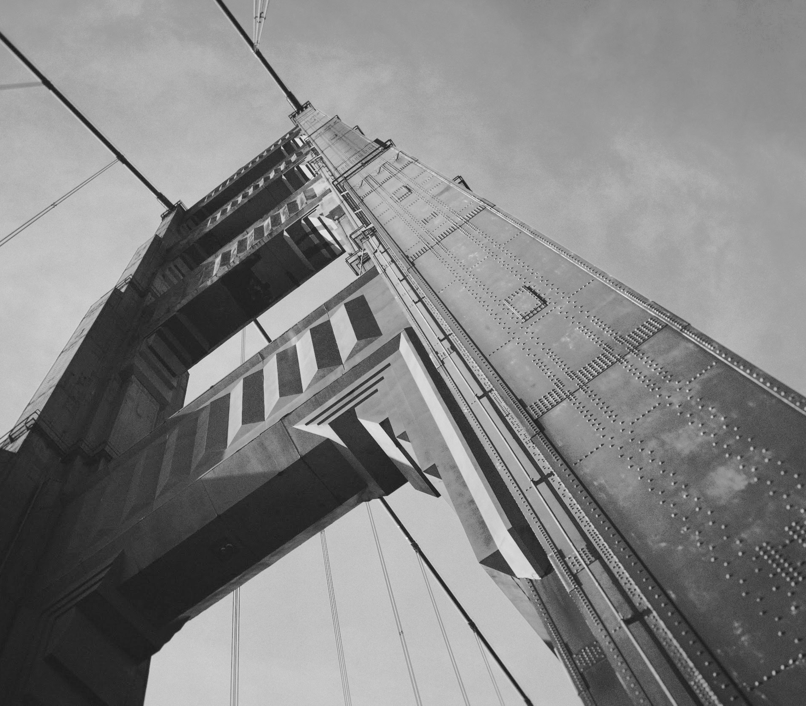
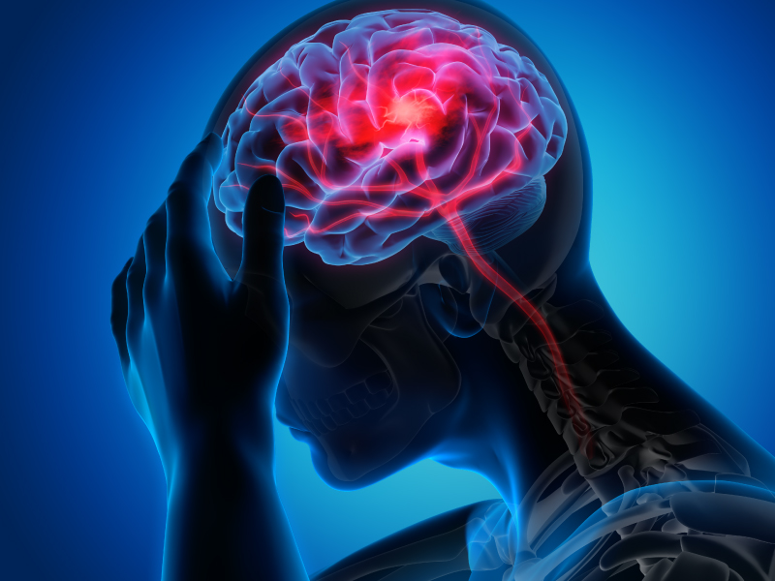
Thanks for Listening!
Any Questions?

Slide 22
Citations
Centers for Disease Control and Prevention. (2021, March 17). Stroke Facts. Centers for Disease Control and Prevention. https://www.cdc.gov/stroke/facts.htm.
The Framingham Risk Score: An Appraisal of Its Benefits and Limitations. https://onlinelibrary.wiley.com/doi/abs/10.1111/j.1541-9215.2007.06350.x
https://professional.diabetes.org/diapro/glucose_calc)
https://www.stroke.org/en/professionals/stroke-resource-library/prevention/five-fast-facts-about-stroke

